Slide 1
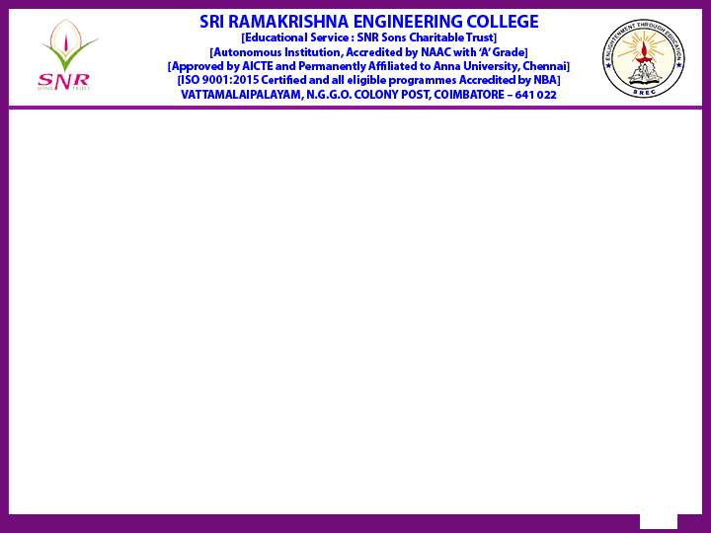
Reaccredited by NAAC with A+ grade]
Batch No : 47
2025 – Mini Project II
“Smart Irrigation Schedular using Forecast and Soil Moisture ”
Type of Project: Application based
Presented by
Kabindra pun magar – 71812301170
Bishwanath Yadav-71812301168
Supervised by
Dr. R. Madhumathi
Associate professor /CSE
Review Type : Zeroth review
Date : 26/07/2025

Slide 2
Contents
S.No | Description | Slide Number
1 | Introduction | 3
2 | Existing technology of the project | 4
3 | Problem identification, scope and objective | 9
4 | Methodology | 10
5 | Timeline | 11
6 | Proposed Outcome and budget | 13
7 | References | 14

Slide 3
Introduction
Water scarcity and inefficient agricultural practices appear to that the course of sustainable farming. Conventional-irrigation systems work on fixed timing schedules, or decisions are made by human intervention. Such practices lead to overwatering or under-watering of crops, which adversely affects crop yield while also wasting an invaluable resource-water. With the advent of Artificial Intelligence, Machine Learning, and smart sensing technologies comes a promise to cure the problem. This project of smart irrigation scheduler using weather forecast and soil moisture intends to tailor irrigation methods according to water needs predicted from real-time environmental parameters and past data. A machine learning model trained on datasets from various sources of soil moisture, temperature, humidity, and rainfall forecasts enables the system to intelligently decide whether irrigation is required. To minimize human intervention and save water and to promote efficient agricultural practice based on numbers, this is the correct system. The system can work for farms, greenhouses, or gardens and provide a scalable and sustainable option for smart irrigation management.

Slide 4
Current technology of the project
The study under review deeply explored advanced field-based irrigation scheduling methods using high-resolution weather forecast data coupled with soil moisture modeling. Contrary to mere IoT-type irrigation systems, this work considered a properly validated crop-water balance model coupled with real-time meteorological forecasts in the decision-making process for irrigation application. Field tests were carried out over different seasons to check for operational water efficiency and crop productivity. The work emphasizes the potential of predictive models over rule-based systems and provides some practical frameworks that could be employed to integrate forecasting in large-scale irrigation planning for farms.
Source: “” Jamal, U. A., et al., published in Water Resources Research (AGU), VoReal‐Time Irrigation Scheduling Based on Weather Forecasts: Field Observations and Modelingl. 59, Issue 11, Article e2023WR034276 (2023); Scopus-indexed

Slide 5
Current technology of the project
The study reveals an advanced intelligent irrigation system which incorporates weather forecast APIs with real-time sensor data. The NodeMCU serves to control a water pump based on environmental logic emerging from ground dryness and expected rainfall. A simple mobile interface notifies farmers of the system status and allows manual override. The project provides less human interaction and more water saving through smart irrigation decisions based on live analytics.
Source: “Smart Irrigation System with Real Time Weather Monitoring” Bhuvaneshwaran, P. Rajasekar, M. Saravanan, published in IJNRD Vol. 9, Issue 2, pp. 116–120 (2024); not Scopus-indexed.

Slide 6
Current technology of the project
The research work establishes a pioneering approach in irrigation management wherein it is possible to forecast soil moisture using the consumption charges incurred by pumping based on transmission from SEMs installed in high-density groundwater pumping wells in the North China Plain. The system uses E-Wc for converting electricity usage into irrigation time and water amount. The smartphone application, combined with weather data, soil property, and crop requirements, simulates current and forecast soil water levels. It was thoroughly validated in the field on winter wheat and summer maize with excellent accuracy for soil moisture prediction and irrigation timing. It's an affordable and viable option for the entire water management scenario in agriculture and in protecting groundwater.
Source: “Soil moisture forecasting for precision irrigation management using real-time electricity consumption records” Xudong Feng, Shaojie Bi, Hongjun Li, Yongqing Qi, Suying Chen, Liwei Shao, published in Agricultural Water Management, Vol. 291, Article ID 108656 (2024), available online 29 Dec 2023; Elsevier.

Slide 7
Current technology of the project
Agriculture supports most of the population around the world. Places like Punjab in India earn their livelihood based on farming in conjunction with other businesses. But, conventional irrigation procedures lead to wastage of water, environmental degradation, and crop damage. The Smart Irrigation System Using Weather Forecasting is an integration of Arduino Uno and NodeMCU with sensors like DHT11, soil moisture, LDR, and raindrop. It provides the option for real-time monitoring and control using the Blynk app. It is also supported by a weather application driving live data from OpenWeatherMap. The machine learning model is trained to produce best irrigation schedules to prevent using water unnecessarily before an untimely rain, which would improve crop yield and sustainability. This system ensures a cradle-to-the-grave approach to being cheap, easy to use, and scalable for precision farming to tackle the world water scarcity and bring to improve resource management efficiency.
Source: “IoT Based Smart Irrigation System Using Weather Forecasting”Nitesh Yadav (Lovely Professional University), published in IJSR, Vol. 13, Issue 1, pp. 930–936 (Jan 2024), DOI: 10.21275/SR24114035017.

Slide 8
Current technology of the project
The paper puts forth an intelligent irrigation system for automatic irrigation using IoT that employs capacitive soil moisture sensing and weather forecasting data. The data come into the capability of the Node MCU module and offers a comparison between moisture value and the given threshold. The module then uses the forecasted probability of rainfall in the decision of whether or not to irrigate. Manual override is available to the farmer on the cloud dashboard. The results reveal a spectacular reduction in the use of water with much better improvement in plant health and system response.
Source: “IoT-Based Smart Irrigation Using Weather Forecast and Soil Moisture Sensor” author:-Shivani, K. N. Swathi, A. P. Kumari, published in IJRPR Vol. 5, Issue 3, pp. 881–885 (2024); not Scopus-indexed.

Slide 9
Problem identification, scope and objectives
Problem Identification :-
Traditional irrigation methods waste significant amounts of water.
Farmers often rely on intuition rather than real-time data for watering schedules.
Over-irrigation or under-irrigation leads to poor crop yield and soil degradation.
Weather uncertainty and lack of soil monitoring increase inefficiency in water use.
Scope of the Project :-
Develop a data-driven model to predict optimal irrigation timings.
Integrate weather forecast and soil moisture data for intelligent scheduling.
Optionally use sensors and IoT for real-time soil data collection and automation.
Can be adapted to various crops, climates, and geographic regions.
Objectives :-
Build a machine learning model to predict when and how much to irrigate.
Use weather and soil moisture datasets to train the model.
Provide real-time irrigation recommendations or automate irrigation.
Minimize water usage while maximizing crop health and yield.
Support future expansion with hardware integration and mobile/web interfaces.

Slide 10
Methodology to be adopted
Sensors
Real time data collection
Weather forecast API
Historical weather and irrigation data
Data preprocessing
ML Model
Prediction (when & how much to irrigate)
Actuator / Pump Control
Web interface for farmer interaction

Slide 11
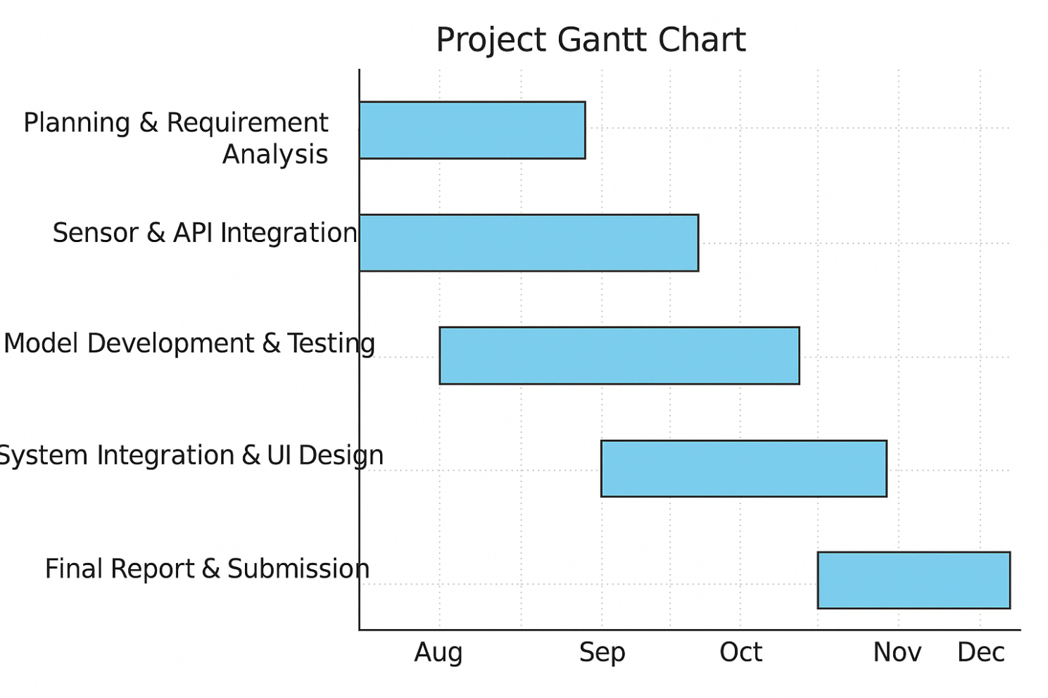
Timeline of the Project and Budget

Slide 12
Timeline of the Project and Budget
Item | Quantity | Approx. Cost (INR) | Remarks
Soil Moisture Sensor (e.g., YL-69) | 2 | ₹150 × 2 = ₹300 | For sensing soil moisture level
DHT11 (Temp + Humidity sensor) | 1 | ₹200 | Optional – for local temperature/humidity
NodeMCU (ESP8266) / Arduino UNO | 1 | ₹350–₹450 | Microcontroller for connecting sensors
Relay Module (Single channel) | 1 | ₹120 | To control water pump
Submersible Mini Water Pump | 1 | ₹250–₹300 | For irrigation purpose
Jumper wires, resistors, breadboard | 1 set | ₹150 | General components
Power Adapter / Battery | 1 | ₹250 | For powering the controller
IoT Cloud Platform / Web Hosting | 1 | ₹0–₹300 | Free tier options available (ThingSpeak, Blynk)

Slide 13
Proposed Outcome of the Project
By the end of the project, the system is expected to achieve the following goals:
Predict irrigation needs accurately using machine learning models on the input of weather forecast and soil moisture data.
Optimize water use so that unnecessary irrigation can be avoided, increasing the conservation of water.
Provide suggestions or allow real-time irrigation decisions to be made through an easily accessible interface or physical set-up.
Allow for implementation in real life using optional hardware (moisture sensors, microcontrollers, etc.) turn-key automated irrigation.
Should be scalable and customized for soils of varying types, weather conditions, and crop requirements.
Not only are the farmers going to benefit from this system, but also researchers, government schemes, and smart agricultural start-ups trying to increase the water efficiency and crop yield.

Slide 14
References
Smart Irrigation System with Real Time Weather Monitoring. https://www.researchgate.net/publication/378031593_IoT_Based_Smart_Irrigation_System_Using_Weather_Forecastin
IoT Based Smart Irrigation System Using Weather Forecasting. https://www.ijirset.com/upload/2024/april/154_Irrigation.pdf
IoT-Based Smart Irrigation Using Weather Forecast and Soil Moisture Sensor. https://www.ijnrd.org/papers/IJNRD2402220.pdf
Real‐Time Irrigation Scheduling Based on Weather Forecasts: Field Observations and Modeling. https://pdf.sciencedirectassets.com/779816/1-s2.0-S2772375524X00040/1-s2.0-S2772375524002971/main.pdf?X-Amz-Security-Token=IQoJb3J
Soil moisture forecasting for precision irrigation management using real-time electricity consumption record. https://agupubs.onlinelibrary.wiley.com/doi/full/10.1029/2023WR035810

